Slide 1

Bio-ASP LAB
Mini Workshop 2020
Voice/Speech Activity Detection
Presenter: 于 晟
Advisor: 曹 昱 博士

Slide 2
Personal Profile
Educational Background
國立交通大學電子工程學系學士
國立台灣大學電子工程學研究所碩士
中央研究院資創中心研究助理
國立台灣大學電子工程學研究所博士班錄取
Research Topics
Speech Enhancement
Voice Activity Detection
Ensemble learning Frameworks
Time-Domain Speech Signal Processing
Speech Feature/Attribute Investigation
Deep Learning Model Pruning/Quantization
J. Wu, C. Yu, S.-W. Fu, C.-T. Liu, S.-Y. Chien, Y. Tsao, “Increasing Compactness of Deep Learning Based Speech Enhancement Models with Parameter Pruning and Quantization Techniques,” IEEE SPL-2019.
C. Yu, K.-H. Hung, S.-S. Wang, Y. Tsao, and J.-w. Hung, "Time-Domain Multi-modal Bone/air Conducted Speech Enhancement," IEEE SPL-2020.
C. Yu, R. E. Zezario, S.-S. Wang, J. Sherman, Y.-Y Hsieh, X. Lu, H.-M. Wang, Y. Tsao, “Speech enhancement based on denoising autoencoder with multi-branched encoders,” 2020.
C. Yu, K.-H. Hung, I.-F. Lin, S.-W. Fu, Y. Tsao, J.-w. Hung, “Waveform-based Voice Activity Detection Exploiting Fully Convolutional networks with Multi-Branched Encoders,” 2020.

Slide 3
Voice/Speech Activity Detection (VAD)
What is VAD?
A technique used in speech processing in which the presence or absence of human speech is detected. (WIKI)
When was VAD created?
Voice activity detectors (VADs) were first investigated for use on TASI systems (1959).
Where do we need VAD?
ASR, Communication systems, Speaker Recognition, SE, and … …
How people implement VAD?
Energy level, Statistical model, Noise tracking, Machine learning (Classifier), Deep learning, and … …

Slide 4
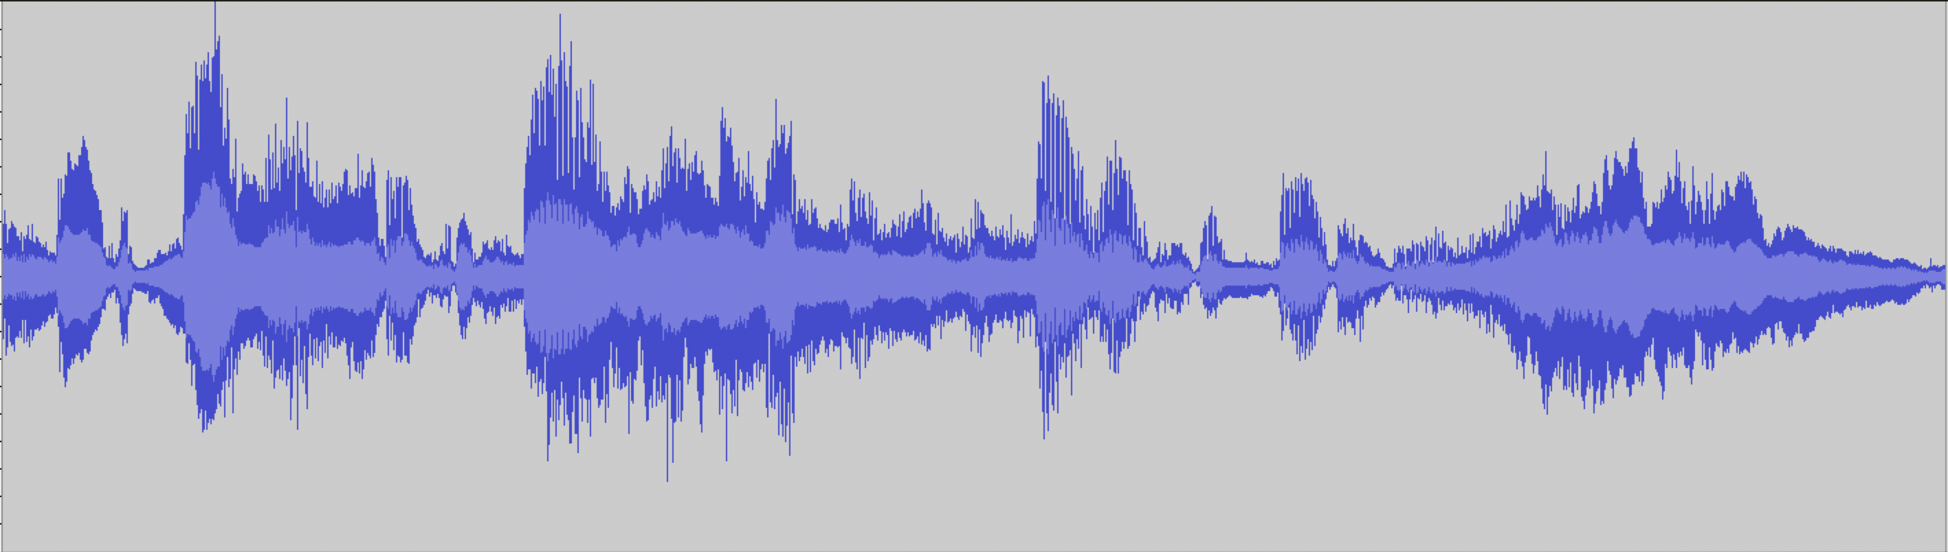

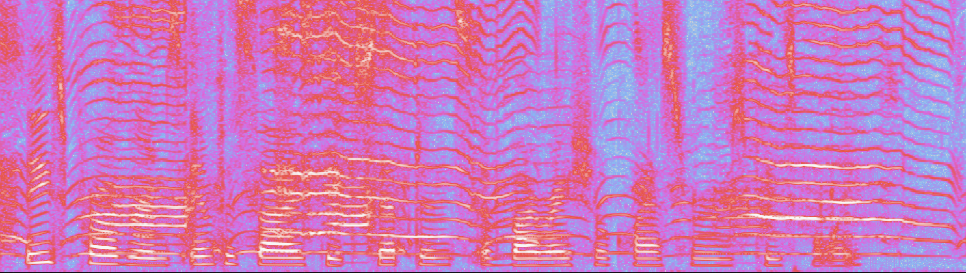
What is VAD?

Slide 5
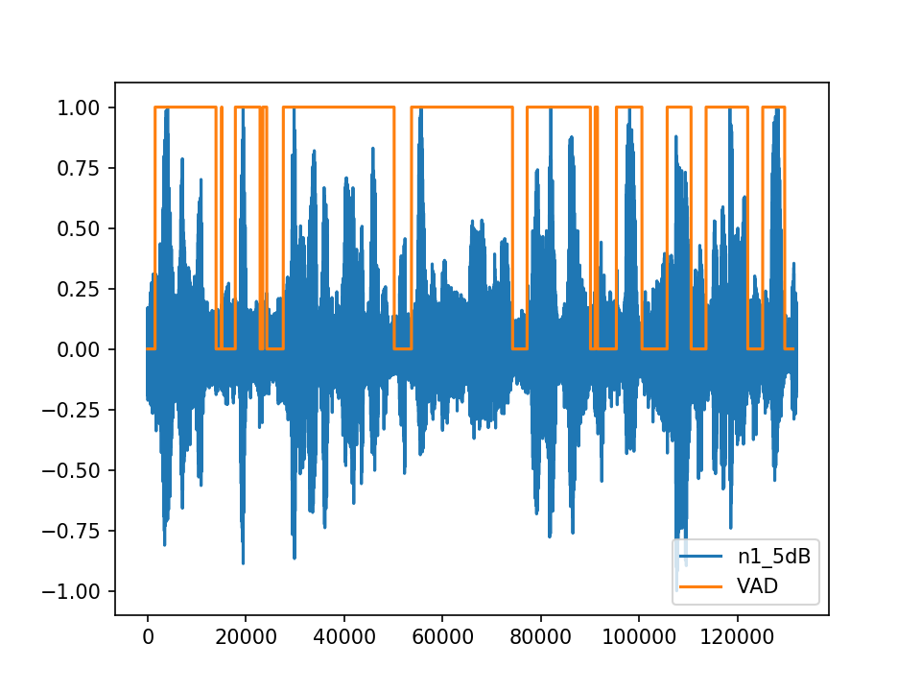
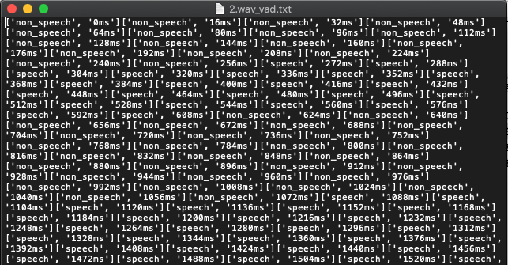
What is VAD exactly?
Signal-wise Demonstration
Discrete time information

Slide 6
When and why VAD?
In early 60’s, scientist and researchers in Bell’s Lab published TASI telecommunication system (a digital speech interpolation system for efficient signal transmission). As a result, it is an important task to detect speech incidents along time axis.
In ASR systems, the recognition performance can sometimes be boosted when given a good VAD label (focuses on speech fractions)
In speaker recognition systems, the background acoustic components are useless or misleading to recognition performances. It is thus crucial that an accurate VAD applied to this research.
In SE systems, it is to our instinct that the VAD can help detect for background noises, and thus takeoff some pressure on enhancement tasks.

Slide 7
VAD implementations
By Task:
Supervised Methods
Unsupervised Methods
By Feature/Method:
Speech Energy Level Methods
Spectral Feature Methods
Statistical Model Methods
Noise Tracking Methods
ML/DL Methods

Slide 8
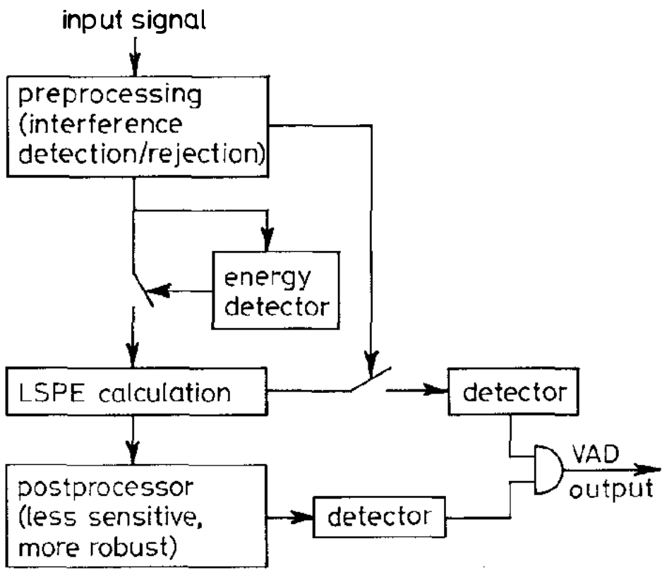
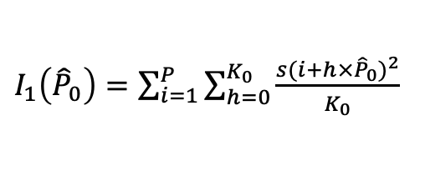
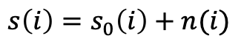
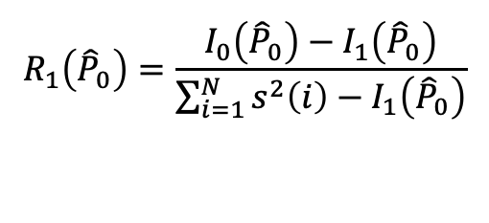
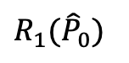
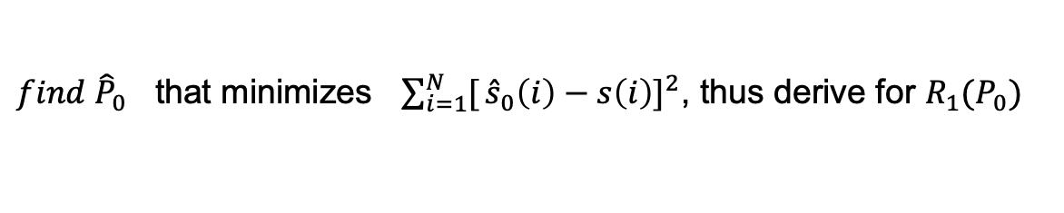
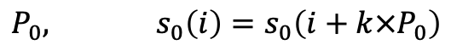
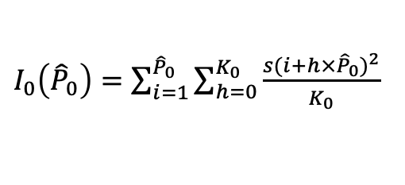
Classic Approach-Energy Level
Voice activity detection using a periodicity measure-1992
LSPE, Least Square Periodic Estimator
$$s\left(i\right)=s_{0}\left(i\right)+n(i)$$
periodic
aperiodic
$$P_{0}, s_{0}\left(i\right)=s_{0}\left(i+k×P_{0}\right)$$
${find \hat{P}}_{0}$ that minimizes ${\sum_{i=1}^{N}{[}\hat{s}}_{0}\left(i\right)−s\left(i\right)]^{2}$, thus derive for $R_{1}(P_{0})$
Periodicity:
$R_{1}({\hat{P}}_{0})$
Energy Detector:
Passing “might be speech” signals.
Reject “not likely speech” signals.
Important to system robustness through
taking out interfering components of
input signals.
$$R_{1}\left({\hat{P}}_{0}\right)=\frac{{I_{0}\left({\hat{P}}_{0}\right)−I}_{1}\left({\hat{P}}_{0}\right)}{\sum_{i=1}^{N}{s^{2}\left(i\right)−I_{1}\left({\hat{P}}_{0}\right)}}$$
$I_{1}\left({\hat{P}}_{0}\right)=\sum_{i=1}^{P}{\sum_{h=0}^{K_{0}}{\frac{s(i+h×{\hat{P}}_{0})^{2}}{K_{0}}}}$
$I_{0}\left({\hat{P}}_{0}\right)=\sum_{i=1}^{{\hat{P}}_{0}}{\sum_{h=0}^{K_{0}}{\frac{s(i+h×{\hat{P}}_{0})^{2}}{K_{0}}}}$

Slide 9
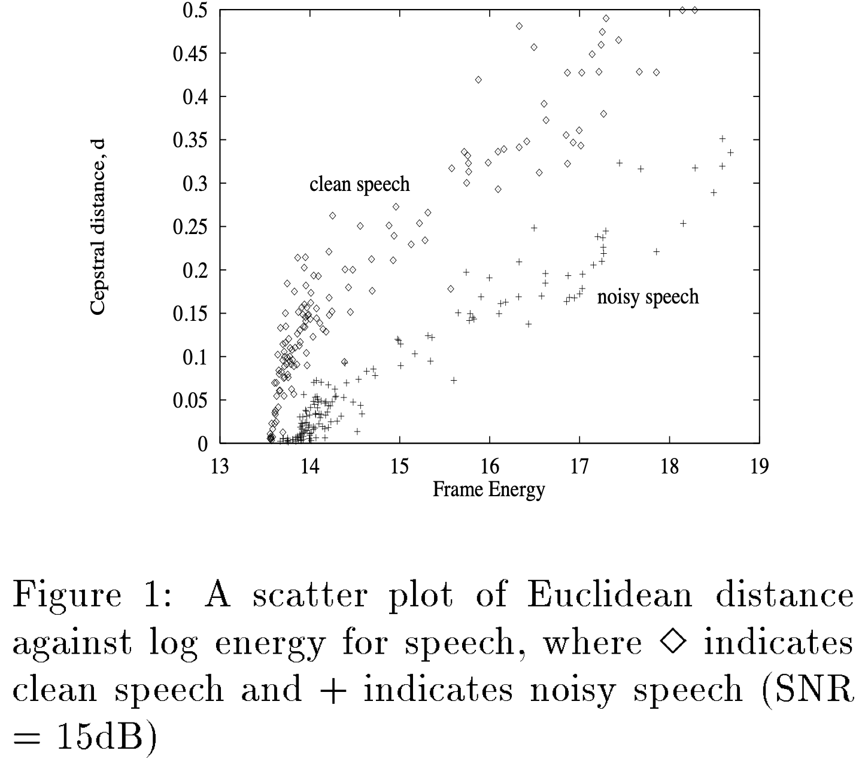
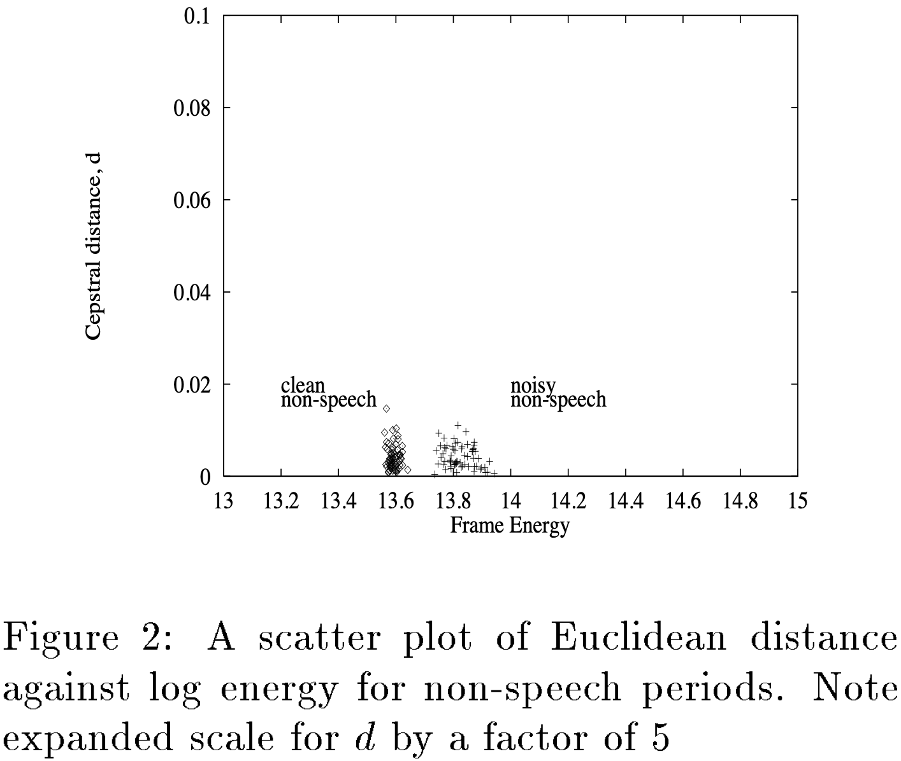
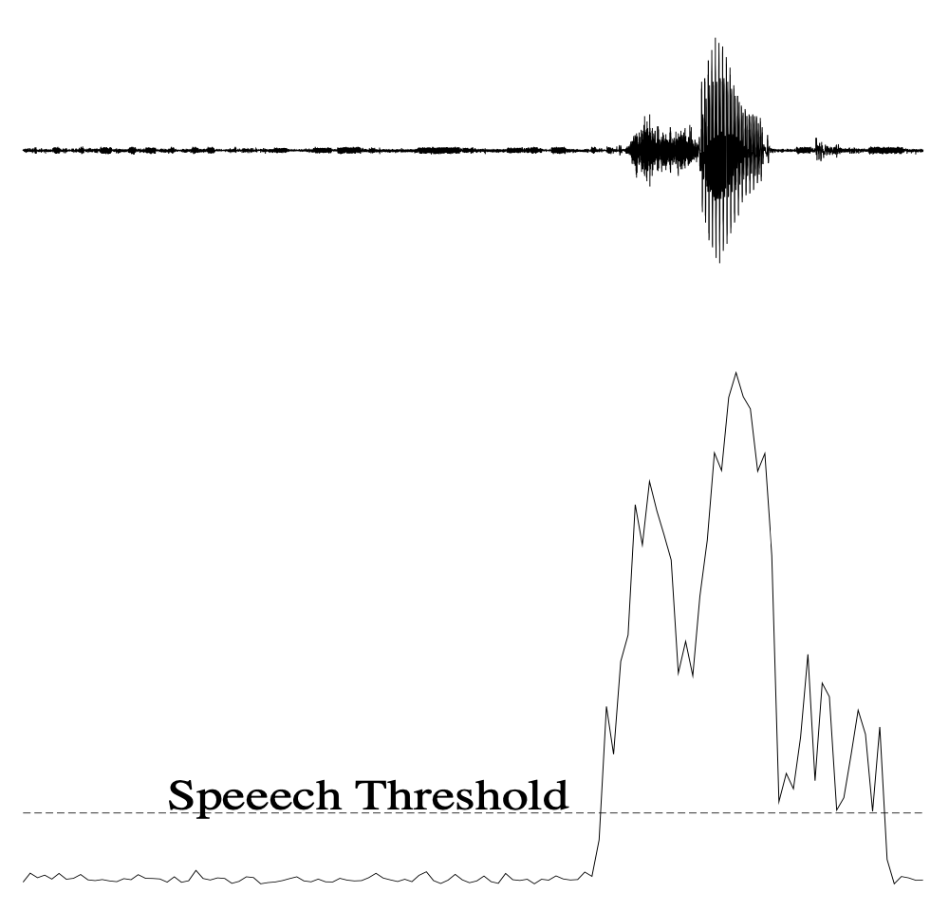
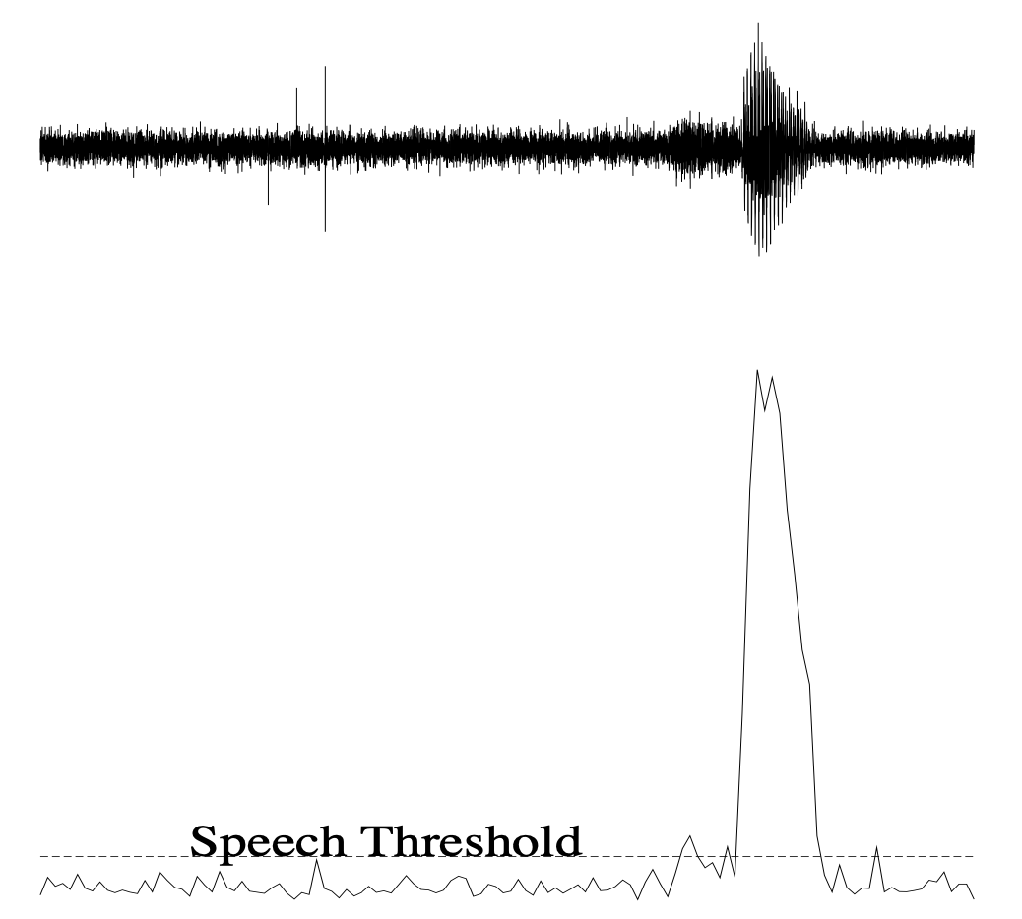
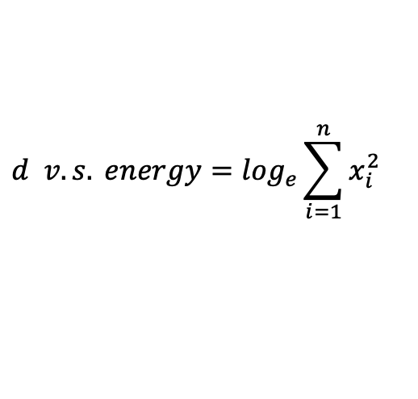
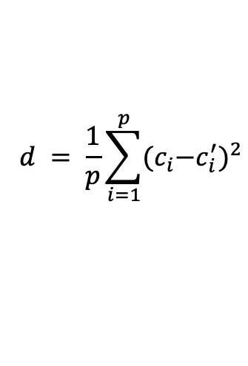
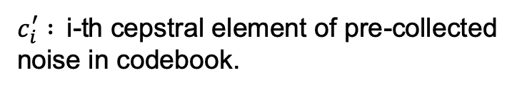
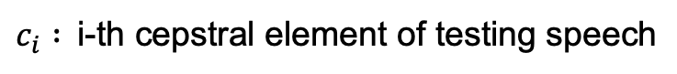
Classic Approach-Energy Level
Robust voice activity detection using cepstral features-1993
$$d = \frac{1}{p}\sum_{i=1}^{p}{{{(c}_{i}−c_{i}^{′})}^{2}}$$
Euclidean distance (an ASR feature):
$c_{i} :$i-th cepstral element of testing speech
$c_{i}^{′} :$i-th cepstral element of pre-collected
noise in codebook.
Characteristics of signal components:
$$d v.s. energy=\log_{e}\sum_{i=1}^{n}{x_{i}^{2}}$$

Slide 10
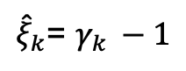
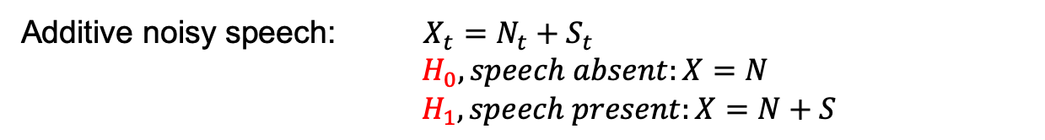
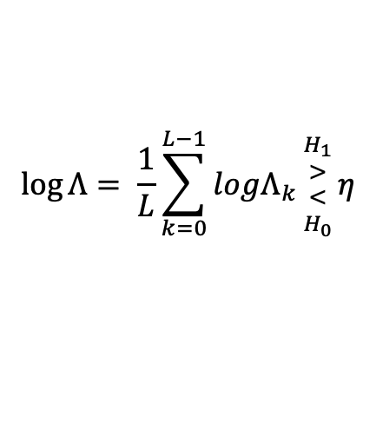
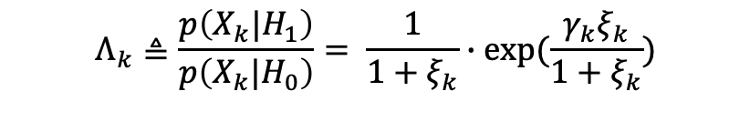
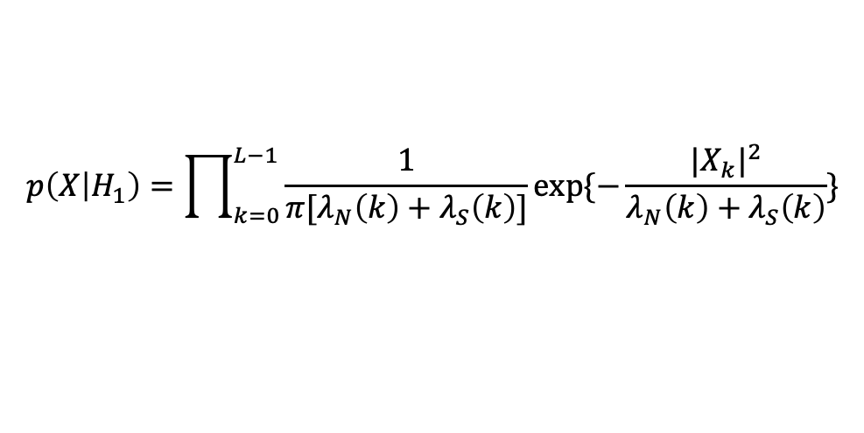
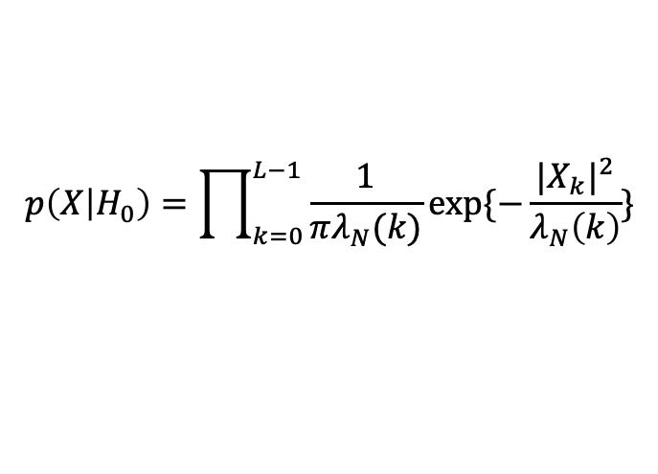
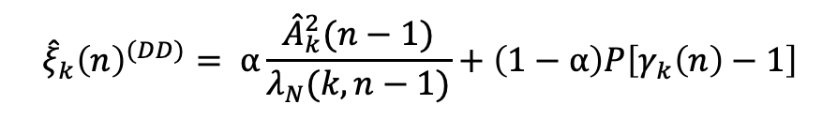
Classic Approach-Statistical Model
A Statistical Model-Based Voice Activity Detection-1999
Additive noisy speech: $X_{t}=N_{t}+S_{t}$
$${ H}_{0}, speech absent:X=N$$
$${ H}_{1}, speech present:X=N+S$$
PDF on conditions:
$$p\left(X | H_{0}\right)=\prod_{k=0}^{L−1}{\frac{1}{πλ_{N}(k)}}exp⁡\{−\frac{|X_{k}|^{2}}{λ_{N}\left(k\right)}\}$$
$$p\left(X | H_{1}\right)=\prod_{k=0}^{L−1}{\frac{1}{π[λ_{N}\left(k\right)+λ_{S}\left(k\right)]}}exp⁡\{−\frac{|X_{k}|^{2}}{λ_{N}\left(k\right)+λ_{S}\left(k\right)}\}$$
Likelihood Ratio:
$$Λ_{k}≜\frac{p\left(X_{k}{|H}_{1}\right)}{p\left(X_{k}{|H}_{0}\right)}= \frac{1}{1+ξ_{k}}∙exp⁡(\frac{{γ_{k}ξ}_{k}}{1+ξ_{k}})$$
GM of LR:
$$\log{Λ}= \frac{1}{L}\sum_{k=0}^{L−1}{logΛ_{k}{{H_{1} \atop >} \atop {< \atop H_{0}}}}η$$
$${\hat{ξ}}_{k}{\left(n\right)}^{(DD)}= α\frac{{\hat{A}}_{k}^{2}(n−1)}{λ_{N}(k,n−1)}+\left(1−α\right)P\left[γ_{k}\left(n\right)−1\right]$$
1. ML:
${\hat{ξ}}_{k}$= $γ_{k }−1$
2. DD:

Slide 11
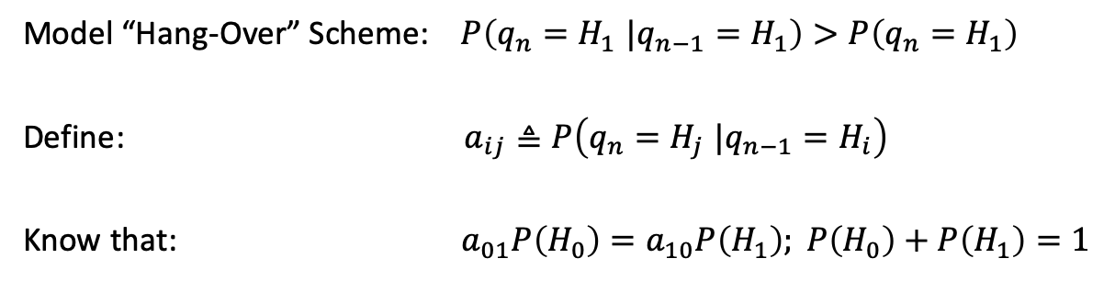
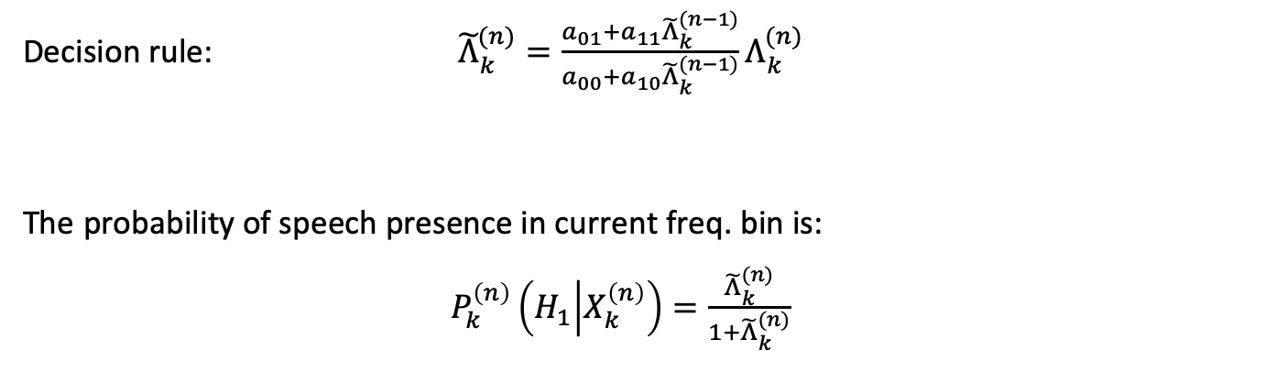
Classic Approach-Statistical Model
A Statistical Model-Based Voice Activity Detection-1999
Model “Hang-Over” Scheme: $P\left(q_{n}{=H}_{1}|q_{n−1}=H_{1}\right)>P\left(q_{n}=H_{1}\right)$
Define: $a_{ij}≜P\left(q_{n}{=H}_{j}|q_{n−1}=H_{i}\right)$
Know that: $a_{01}P\left(H_{0}\right)=a_{10}P\left(H_{1}\right); P\left(H_{0}\right)+P\left(H_{1}\right)=1$
Decision rule: ${\tilde{Λ}}_{k}^{(n)}=\frac{a_{01}+a_{11}{\tilde{Λ}}_{k}^{(n−1)}}{a_{00}+a_{10}{\tilde{Λ}}_{k}^{(n−1)}}Λ_{k}^{(n)}$
The probability of speech presence in current freq. bin is:
$P_{k}^{\left(n\right)}\left(H_{1} | X_{k}^{\left(n\right)}\right)=\frac{{\tilde{Λ}}_{k}^{(n)}}{1+{\tilde{Λ}}_{k}^{(n)}}$

Slide 12
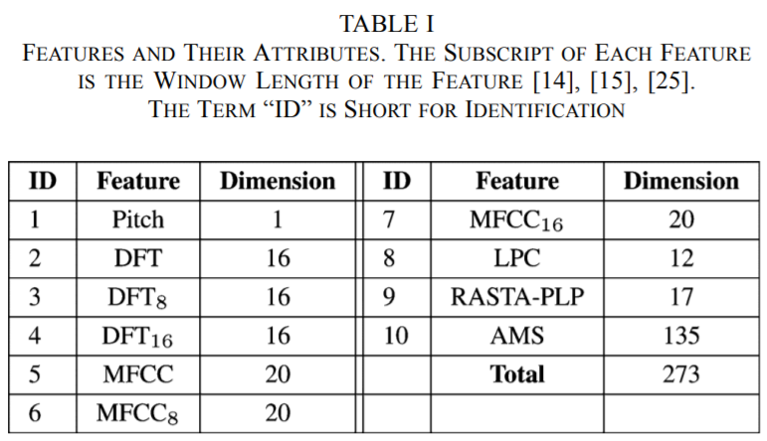
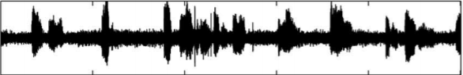
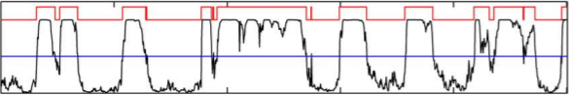
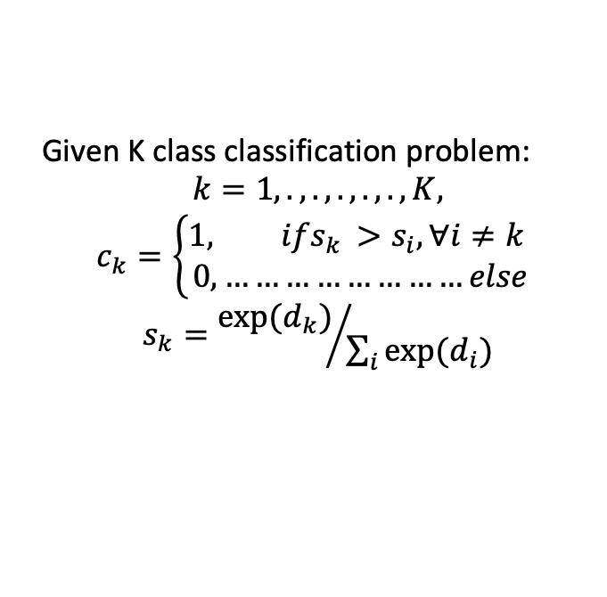
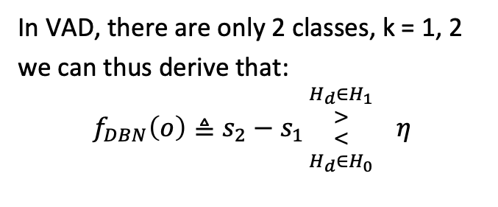
Classic Approach-Deep Belief Network
Deep Belief Networks Based Voice Activity Detection-2013
Feature
Given K class classification problem:
$$k=1,.,.,.,.,.,K,$$
$$c_{k}=\left\{\begin{aligned}1, ifs_{k }{>s}_{i},∀i≠k \\ 0,……………………else\end{aligned}\right.$$
$$s_{k}={exp(d_{k})}/{\sum_{i}{exp(d_{i})}}$$
Restrict Boltzmann Machine
In VAD, there are only 2 classes, k = 1, 2
we can thus derive that:
$$f_{DBN}\left(o\right)≜s_{2}−s_{1}{{H_{d}{∈H}_{1} \atop >} \atop {< \atop H_{d}{∈H}_{0}}} η$$
1
0
0
VAD label

Slide 13
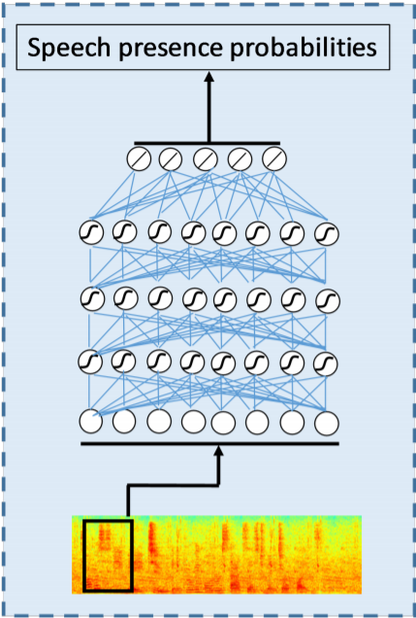
Classic Approach-DNN

Slide 14
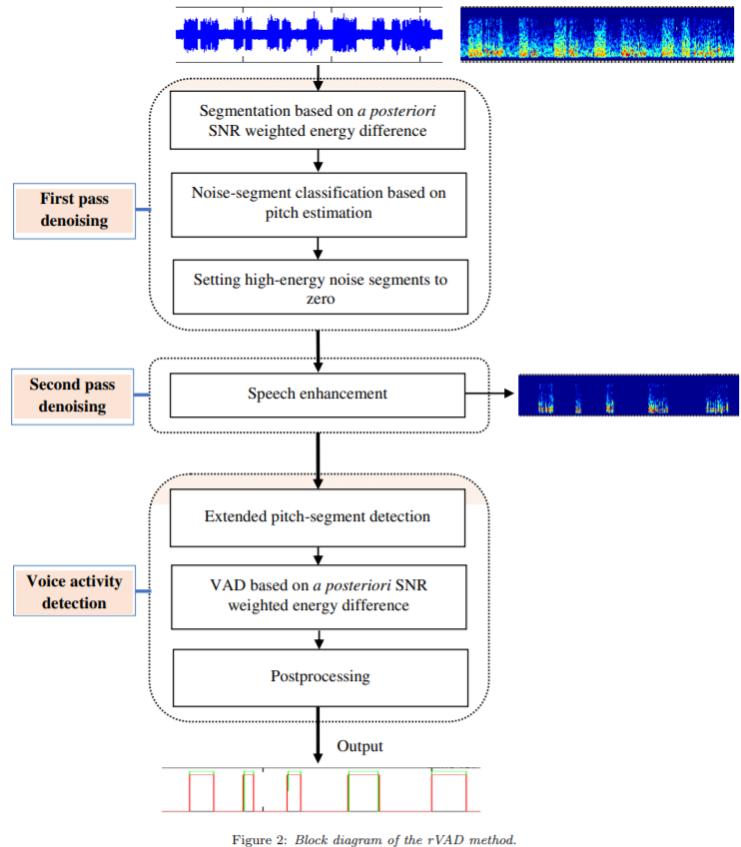
Classic Approach-rVAD

Slide 15
Learn from the past, what we need?
An entropy function of time with better
representation of speech presence probability
2. A good decision/post-processing mechanism
that is precise with marginal compromise.

Slide 16
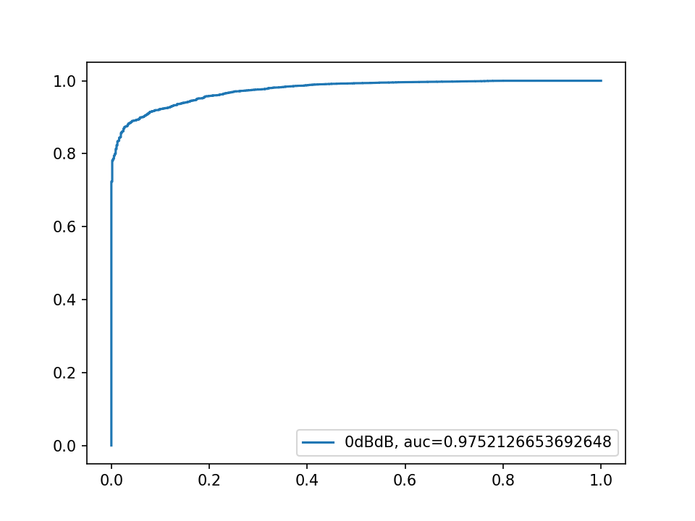
How do we evaluate?
Direct Accuracy
ROC (Receiver operating characteristics)
-speech detection versus false alarm
AUC(Area under ROC curve)
DCF(Detection Cost Function)
-weighted sum of false alarm and false rejection
ROC curve

Slide 17
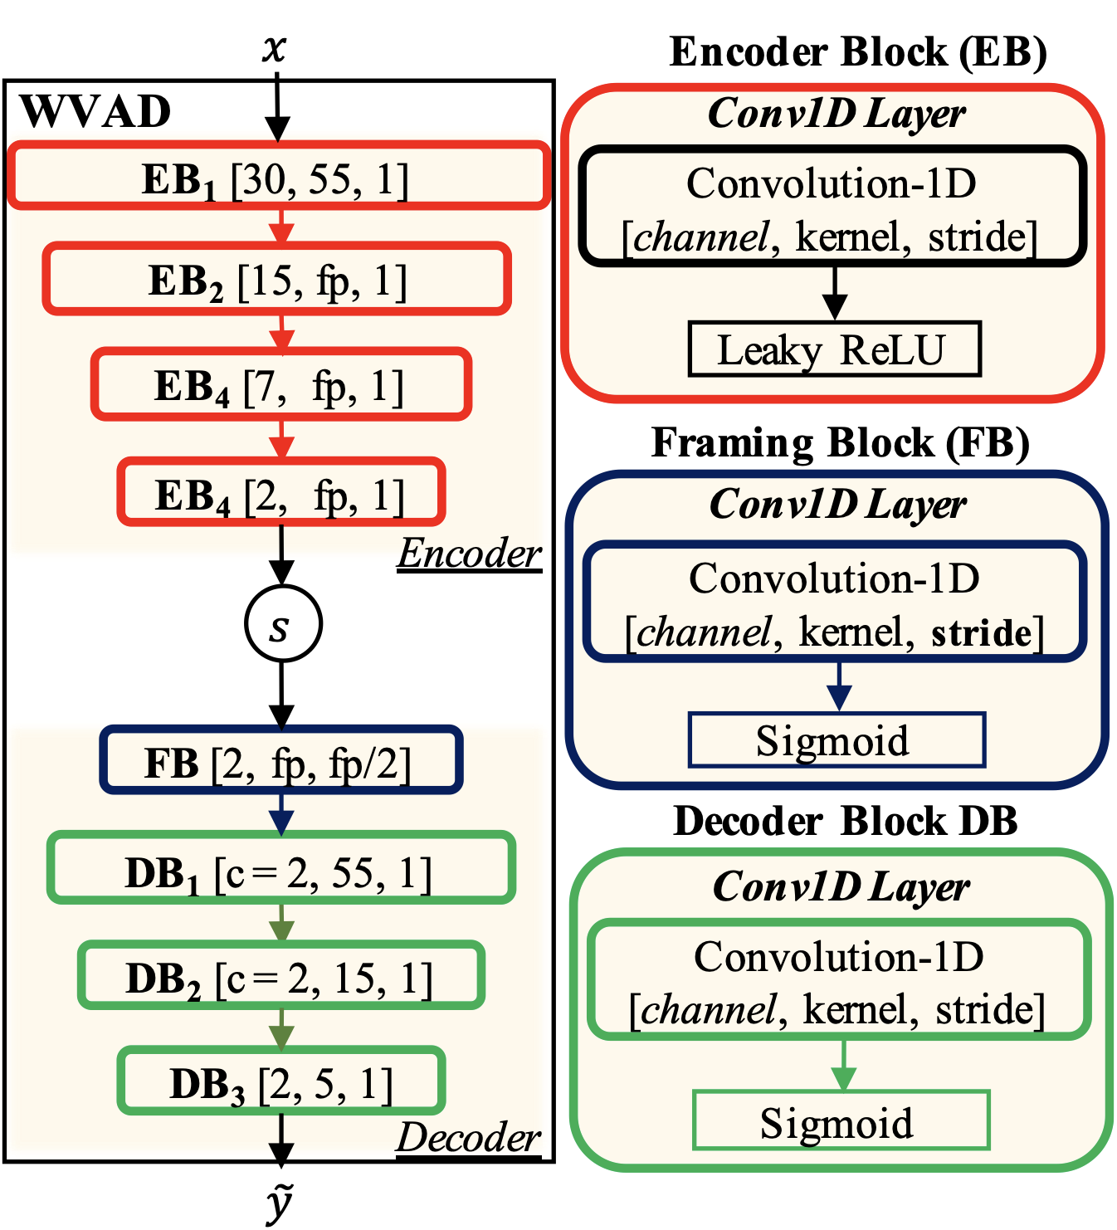
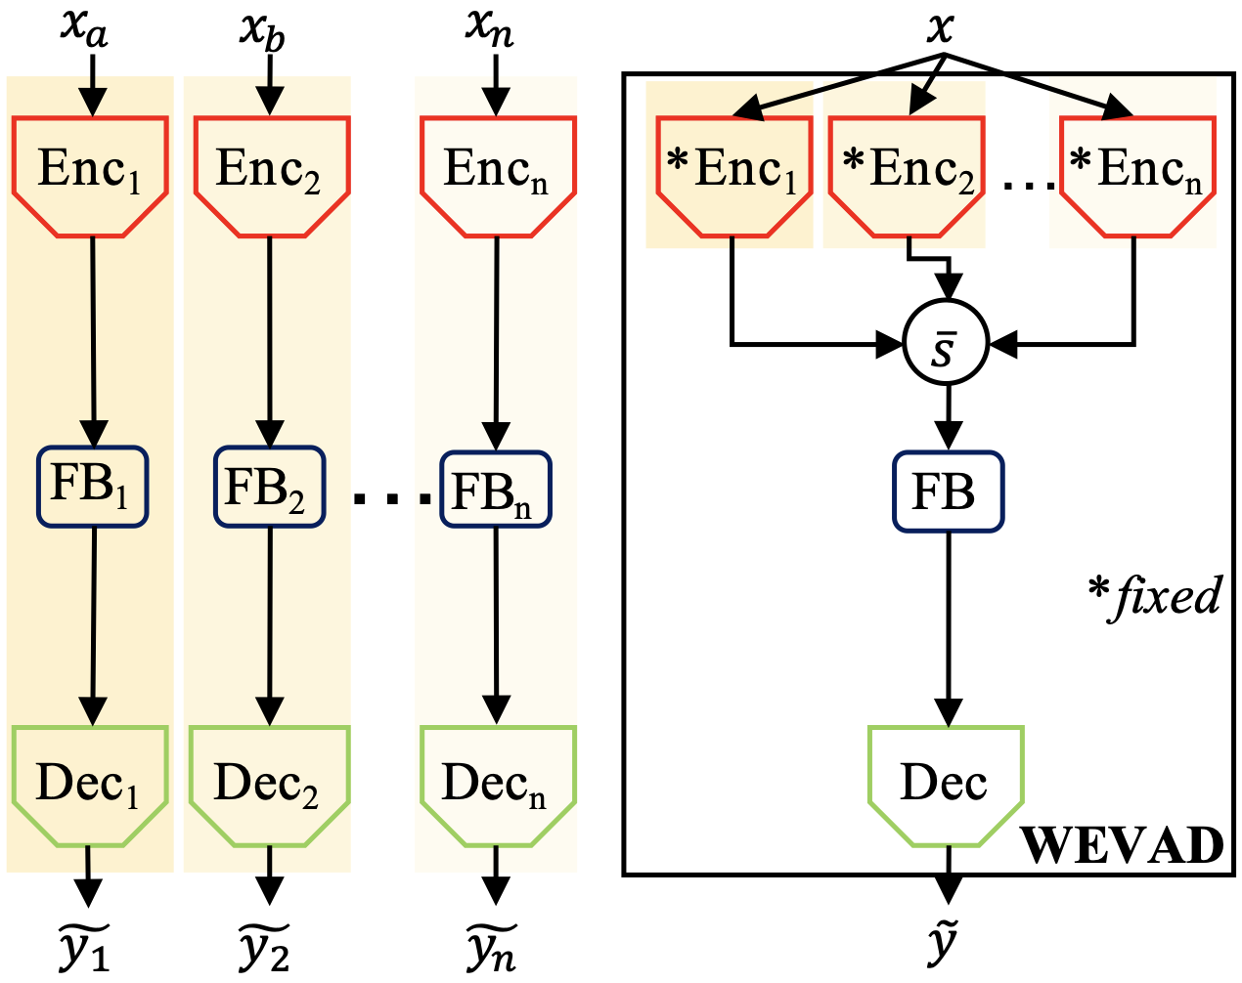
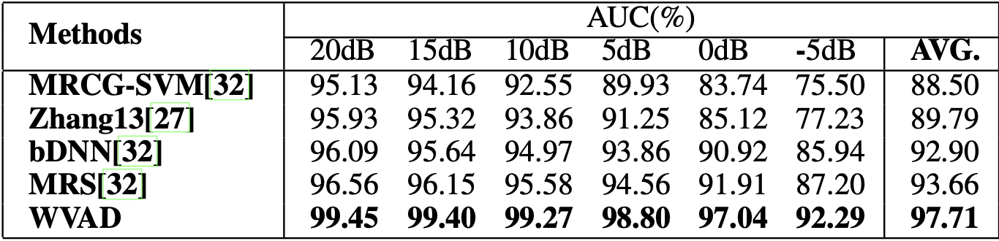
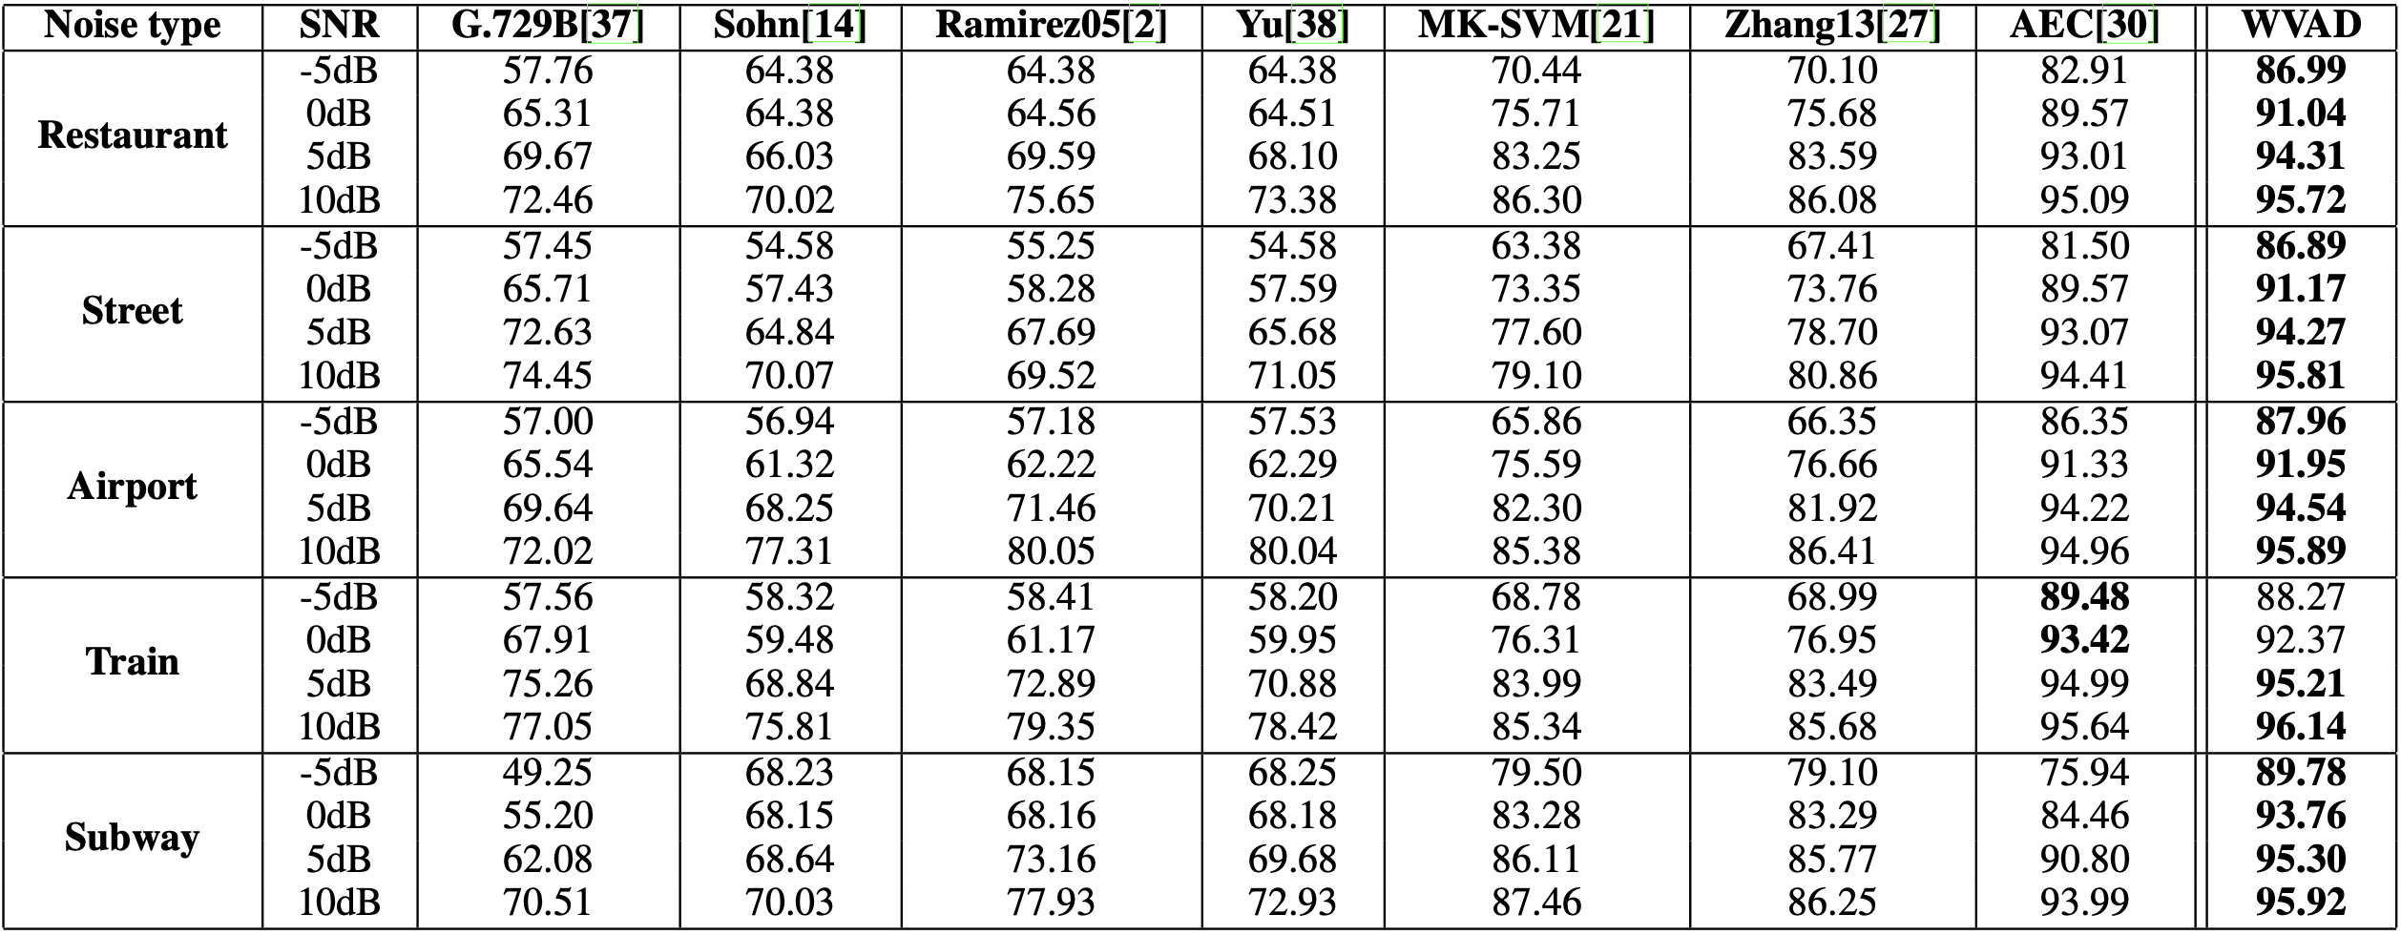
WVAD/WEVAD-2020@Bio-ASP LAB

Slide 18
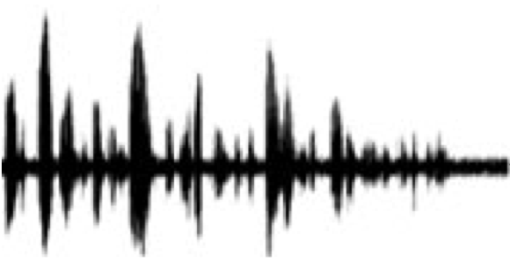
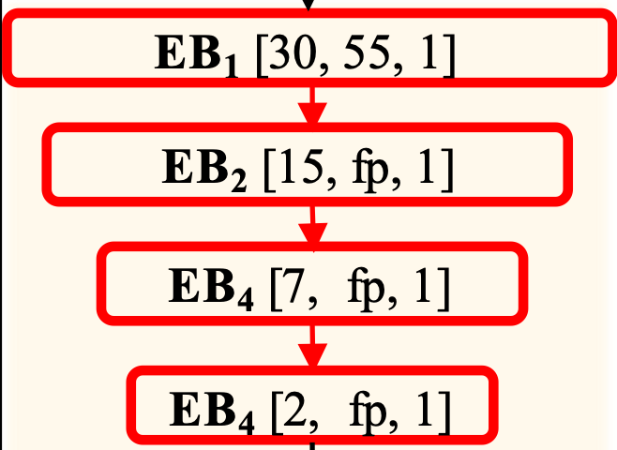
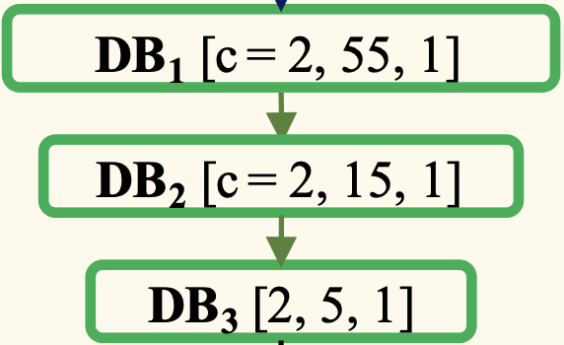
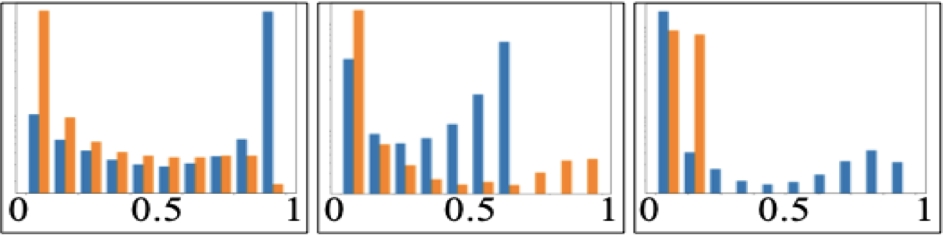
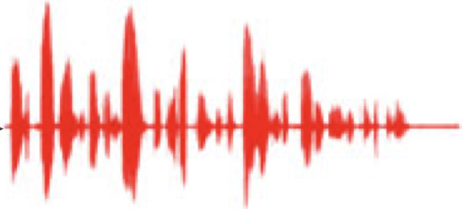
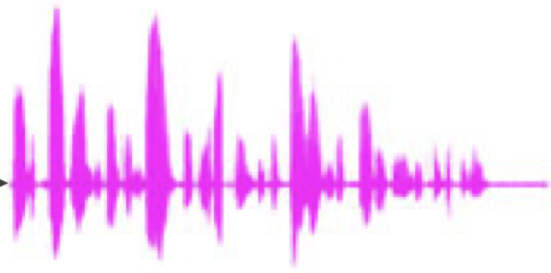
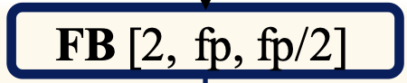
WVAD/WEVAD-2020@Bio-ASP LAB
0.3, 0.2, 0.9, ……
0.7, 0.8, 0.1, ……

Slide 19
WVAD/WEVAD-2020@Bio-ASP LAB

